Slide 1
Climate Café Facilitators Training
Jennifer Fendya, Ph.D.
Wendy Greenspun, Ph.D.
Climate Psychology Alliance-NA

Slide 2
Review of Agenda
Introduction to Climate Café Model
Experiential “Taster” Climate Café
Processing the experience
How to organize your own Climate Café
Questions

Slide 3
Opening Question
Where or with whom do you talk most easily about the climate crisis?

Slide 4
What can happen when we don’t process our climate emotions
Drug/alcohol overuse
Nihilism
Hedonism
Self-harm behavior
Suicidality
Frantic action
Shutting down
Martyr complex
Bunker mentality
Dysregulated emotions
Burnout
All-or-none thinking
Othering

Slide 5
Why Climate Cafes?
A group format can create a safe or brave place to process these feelings and build a sense of community and shared meaning
Shared vulnerability can lighten the emotional burden; co-regulation can calm the nervous system
Complex nature of climate crisis- no quick or easy solutions; the accompanying feelings are also complex, with no quick or easy solutions
Sharing thoughts, feelings and experiences can open new ways of thinking and may facilitate a capacity for deeper engagement

Slide 6
Principles of a Climate Cafe
An informal, open, respectful, private space to safely share emotional responses and reactions related to the climate and environmental emergency (i.e. a “container”)
NOT a therapy group, but a quiet, reflective, supportive group meeting that is a haven from usual busyness and activity
No intention of leading participants to any conclusion or toward action (actions can be discussed, but reflection is paramount)
Exploration of thoughts, feelings and experiences rather than what we are DOING about the climate crisis
No expectation of “feeling better” as a result of the café or even that every group will get to deeper feelings

Slide 7
Who can facilitate climate cafes?
Mental health clinicians: can apply clinical knowledge and experience, especially group skills
Non-clinicians who have facilitation skills and/or group leadership experience
Ongoing support can be an essential component of facilitation
Co-facilitation with someone experienced with groups can also be helpful
Photo: Providence Doucet

Slide 8
GROUND RULES
Take turns speaking; refrain from interrupting
When speaking, be mindful of time
Listen when others are talking
Respect everyone’s perspective; don’t impose own views on others
“Ouch!”- naming and repairing inadvertent slights or harms
Allow space for silence
The café is a place to share feelings about the climate crisis to whatever degree is comfortable, but again is NOT a clinical space

Slide 9
Climate Café Process
AS A WAY FOR MEMBERS TO INTRODUCE THEMSELVES:
“Choose a natural object that connects you to the climate crisis, one on hand or one in our basket. Use this object as a way of telling us:
Something about yourself
Something about the planetary crisis
Something that led you to come to the climate café”
(You should have on hand a basket of natural objects as samples, in person or remote)
One facilitator begins the introductions, then asks, “Did anyone connect to what was just said? Can you speak to how and then do your own introduction?” If you have a co-facilitator, they will do the last introduction in the group.
NEXT STEP: “Tell us about anything that came up for you during the introductions- thoughts, feelings, reflections”
Facilitator provides holding function, makes connecting remarks, shares some of own responses and reflects and inquires about thoughts and feelings

Slide 10
How to End the Café: Summary and Closure
Last ten minutes- acknowledge the ending coming, invite anyone who hasn’t yet spoken to have the opportunity, and ask if there might be anything else not yet shared that feels important
Facilitator(s) reflect and summarize feelings and themes
Provide closure: e.g “One word to describe what you’ve harvested from this experience”
Provide resources if desired (we will go over later)

Slide 11
Ready to taste the coffee?
Experiential Climate Café

Slide 12
Processing the Experience
How did it feel to be a participant?
Did you notice any resistances (within yourself or the group) to talking about or staying with any of the feelings? Were you left unsettled in any way?

Slide 13
Brief Break- 3 minutes (and put any questions that have come up so far in the chat)

Slide 14
Facilitating a Climate Café: The Facilitator’s Role
Create a sense of safety in the group
Be warm and welcoming, as if in an actual café
Remind members of the ground rules
Examples of useful prompts: “What is it like to stay with the feelings?” “Can you name the feeling as you talk about X” “I wonder how we can understand this silence?”
Focus on process (what is occurring with an individual or in the group), not content (specific topics being discussed)
Focus at group level- “what does the group need right now?”

Slide 15
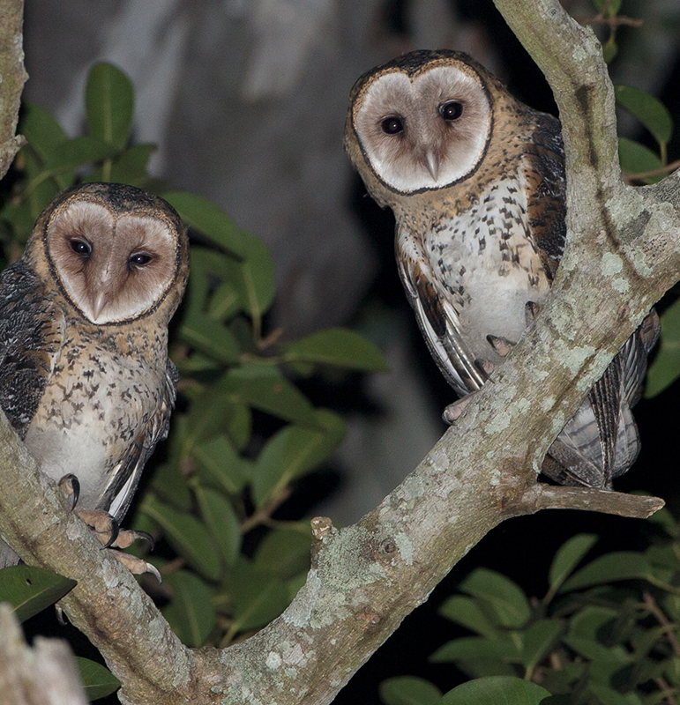
Co-Facilitation
Very helpful to help hold the emotions- model of interconnection
Preparation and debrief are essential
Helps manage entry and endings
Can text or send private chat in case of something urgent
Modeling of rupture and repair- you don’t have to be perfect, there is room for mistakes and unknowns
Can play different roles (time-keeper, giving introduction or instructions)
Self and co-reflection- during the café and after

Slide 16
Challenges that may come up
Very verbal/verbose member who doesn’t make room for others- gently remind of ground rules, name or ask about feelings underneath
Quiet or silent member- need to invite but without pressuring; no one is required to speak
Intellectualized member- use empathic description (“so hard to stay with the feelings”; “I wonder what you’re feeling as you talk about that”)
Microagressions or slights- gently name or inquire, acknowledge the feelings, focus on repair

Slide 17
Dysregulated Emotions: The “Hot Potato”
Intense feelings can sometimes seem “too hot to handle” and we may want to toss them away (e.g. ignore, avoid, change the topic)
However …. hot feelings might be an expression of what others feel but are not yet aware of or don’t know how to articulate
PIxaby

Slide 18
How to recognize if an individual in the café needs additional help with their emotions
If they are not able to calm themselves within the group structure
If they express extreme level of distress (e.g. thoughts of suicide or self-harm)
If they ask for additional help directly
Photo credit: Danie Franco

Slide 19
Ways to work with dysregulated distress: Work in the Window of Tolerance
Group strategies:
“Are other people feeling this way?” (normalizing and sharing)
Grounding and breath practices for the group
Asking the group: what helps you when you feel distressed?
Individual strategies:
One facilitator can take distressed individual to a breakout room or outside the café, or meet with after the cafe
Role is not as therapist, but to facilitate connections to resources for additional help/support

Slide 20
Resources to have ready for climate café participants
Emotional resources: give tools for grounding, calming, mindfulness -distress tolerance skills
Climate- informed therapist list (see climatepsychology.us)
Suicide or crisis intervention hotline numbers- e.g. 988 crisis hotline
Action resources: possible environmental or climate justice activist groups
Co-facilitators contact information for additional resources if needed

Slide 21
How to Organize Your Own Climate Cafe
Find a co-facilitator, someone with group experience helpful
Identify target audience (e.g. Parents? Teens? Activists? Church members? Specific identities?)
Decide on the frequency and regularity: One time, series or ongoing
Length of the café- usually 1.5 hours but you can decide based on the group
Face to face cafes - coffee shop or community center, food and drink available, quiet space away from others
Virtual: could potentially have more participants
May have low turnout initially- don’t give up!

Slide 22
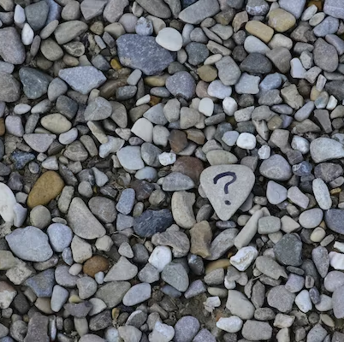
Practical considerations
To waiver or not to waiver? For licensed mental health professionals- setting clear expectations and limiting liability risks
Number of participants?
To charge or not to charge?
Photo: Ana Municio on Unsplash

Slide 23
Publicity
Social media (Facebook, Instagram, Twitter, Meetup, Eventbrite, listservs)
Repeat postings!
Offer phone numbers/emails for inquiries
Encourage people to bring a friend or family member

Slide 24
Recommended additional training experience:
Attend a full climate café as a participant
See listing at: climatepsychologyalliance.org
Possible future climate cafes run by CPA-NA or posted on the listserv

Slide 25
Resources for Facilitators
For CPA Members:
CPA-NA --Monthly Facilitator Support/consultation Meetings: Second Monday of each month, 4-5:15 Eastern time
Register at: https://www.climatepsychology.us/climate-cafes
CPA-UK --Monthly Facilitator Supervision Meeting : First Wednesday of each month, 2:30-4 Eastern Time
Contact admin@climatepsychologyalliance.org
For Member and Non-Member Clinicians:
American Group Psychotherapy Association
agpa.org
For Non-Members:
Talk to your climate café facilitators about starting or joining your own support group

Slide 26
Also for CPA-NA members
Climate Emotion Group Facilitators Hub
Include resources for facilitation, finding a co-facilitator, volunteering for facilitation opportunities
Photo credit: Skye Studios

Slide 27
Please put your name and email address in the chat
… if you’d like information about joining CPA-NA
…. If you’d like information on accessing The Hub for climate-emotion groups
… if you’d like a pdf of these slides

Slide 28
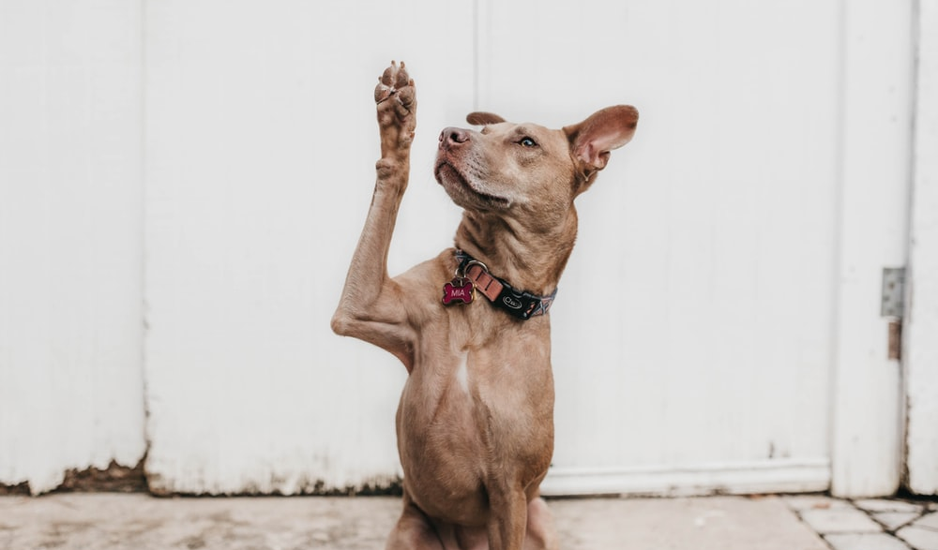
Questions?

